Slide 1
Accompanying Guide to New Question Type Samplers: Mathematics

Slide 2
Table of Contents
Section 1: Introduction and Overview
Section 2: Scoring and Reporting Guide Overview and Question Types
Equation editor
Graphing
Inline choice
Hot spot
Fraction model
Drag and drop
Match table grid
Multiselect
Section 3: Additional Resources

Slide 3
This document provides a guide to navigating the new question type samplers, including scoring and reporting information
All example questions in this guide are from the new question type samplers, which are available here: new question type samplers
Information provided in this document is subject to change following results from the Spring 2022 field test.
Please note the following about the new question type samplers:
Sampler results are not predictive of student performance on the STAAR assessment, and instructional interpretations should not be made from the question type sampler results.
Constructed response questions in the samplers will not be scored because they are handscored.
Not all new question types in the samplers will appear on every STAAR test every year.
Additional information and resources about the STAAR assessment are available here: STAAR Test

Slide 4
State and federal laws require a redesign of Texas’s state summative assessment (STAAR), effective 2022–2023
Assessments provide educators and parents with helpful information to support strong teaching and guide students to their full potential.
STAAR is a summative assessment that serves several primary purposes, including determining student mastery of TEKS, determining effectiveness of curriculum and instruction programs, helping determine which individual students should receive additional holistic supports, and serving as a bar for rigor and standards alignment in planning.
State and federal laws require a redesign of Texas’s state summative assessment (STAAR), effective 2022–2023, that will ensure STAAR is more aligned with how students are learning in the classroom.
One component of the redesign is the addition of new, non-multiple-choice questions to meet a 75% cap on multiple-choice questions.

Slide 5
Any new question type will need to be able to meet our existing rigorous requirements for STAAR questions AND provide additional benefits
New questions will need to meet our existing rigorous requirements for STAAR, including:
Valid statistics from field tests
Alignment with TEKS
Grade-level appropriateness
Lack of bias
Accessibility for all students
Review and approval from a group of Texas educators who teach the grade level and agree students should be able to answer these questions at the end of the year
TEA has worked closely with educators to determine which new question types best support students:
600 educators participated in focus groups on new question types
92% of educators agree that the new question types allow students to better demonstrate their knowledge
89% of educators believe that the new question types are more engaging for students
80%+ of educators agree that new question types will impact instructional planning

Slide 6
The following new question types may be included in the specified Mathematics tests starting in Spring 2023
*Question Type | Question Type Description | STAAR Math Test Titles
Equation editor | Student can write responses in the form of fractions, expressions, equations, or inequalities. | Grades 3-8 EOC
Text Entry | Student responds by typing a brief string of text such as a number, word, or phrase. | Grades 3-8 EOC
Graphing | Student selects, points, draws lines, drags bar graphs, and perform other functions to independently create different types of graphs. | Grades 3-8 EOC
Number line | Student selects a point, an open or closed circle, and a direction arrow to demonstrate a solution set on a number line. | Grades 6-8 EOC
Inline choice | Student selects the correct answer(s) from one or more drop-down menu(s). | Grades 3-8 EOC
Hot spot | Student responds by selecting one or more specific areas of a graphic. | Grades 3-8 EOC
Fraction model | Student represents a fraction by dividing an object into the correct number of sections to indicate the denominator and clicking to shade the appropriate number of sections to indicate the numerator. | Grades 3-5
Drag and drop | Student evaluates a given number of options (words, numbers, symbols, etc.) and chooses which response(s) to drag to a given area (a diagram, map, chart, etc.). | Grades 3-8 EOC
Match table grid | Student matches statements or objects to different categories presented in a table grid. | Grades 6-8 EOC
Multiselect | Student can select more than one correct answer from a set of possible answers. | Grades 3-8 EOC
Max possible points per question
2 points
1 or 2 points
dependent upon question
*Not all new question types will appear on every test every year

Slide 7
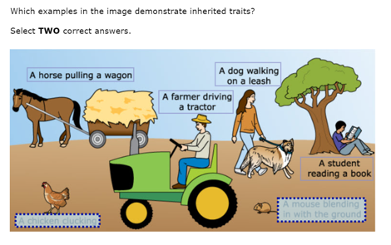
How new question types are reported in the data file
Districts are provided a data file that details student’s answers at an aggregate level:
Actual value or texts will appear in the data file for items such as inline choice or multiple select items.
For new question types such as match table grid or hot spot items, answer choices will be given identifiers.
Student responses will not be transformed into a data file for some items such as graphing or number line.
Data files will be delivered to district users’ TIDE secure inbox.
Sample data file output: Identifiers
For this hot spot item, each answer choice is given a corresponding identifier. In a data file, it will appear that the student selected HS_4, HS_5 (hot spot answer choice 4 and hot spot answer choice 5) for this item.
HS_1
HS_2
HS_3
HS_6
HS_4
HS_5

Slide 8
Scoring and Reporting Information for Each New Question Type

Slide 9
Overview of the scoring and reporting guide
The remainder of this resource includes information about scoring and reporting for each new question type on Mathematics tests.
The first slide for each new question type is an overview that includes a definition, the possible points for the question type, and the grades which may include the question type.
Then, one or more examples of the new question type are given. Each example includes a set of slides:
Student view slides: Student view that includes the question prompt and what the student will see when they select their answer. Example student responses for each possible credit will also be given.
Teacher view slide: Teacher view in the reporting system that includes the scoring model for the question type, the correct answer to the example question, and the score of the student answering the example question.

Slide 10
Question Type: Equation Editor Question Type Overview
Description: Student can write responses in the form of fractions, expressions, equations, or inequalities.
Point value: These questions can be worth a maximum of 2 points with the possibility of receiving 1 point for a partially correct response.
Math tests that may include these questions: Grades 3-8, Spanish Grades 3-5, and EOC

Slide 11
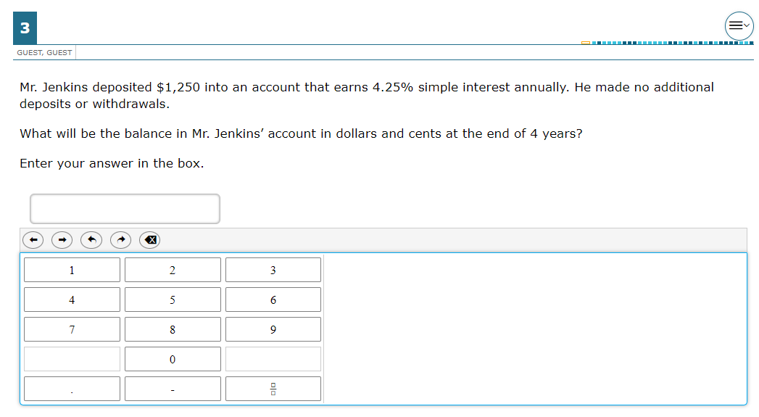
Question Type: Equation Editor Example #1: Student view
This example is question #3 in the Grade 8 sampler.

Slide 12
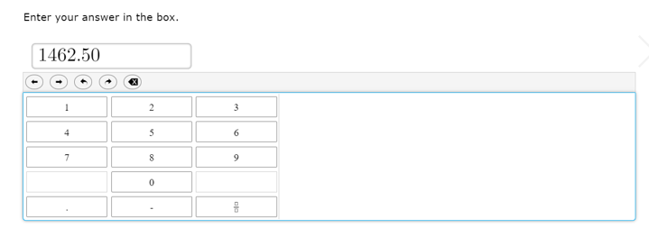
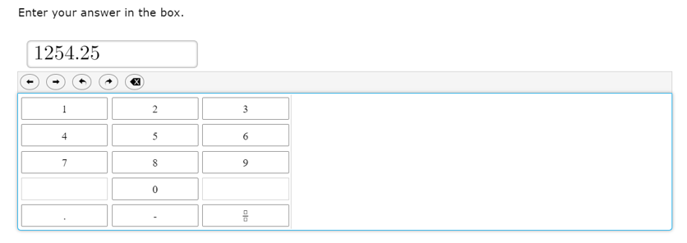
Question Type: Equation Editor Example #1: Student view
This student entered the correct answer (1 point).
This student did not enter the correct answer (0 points).

Slide 13
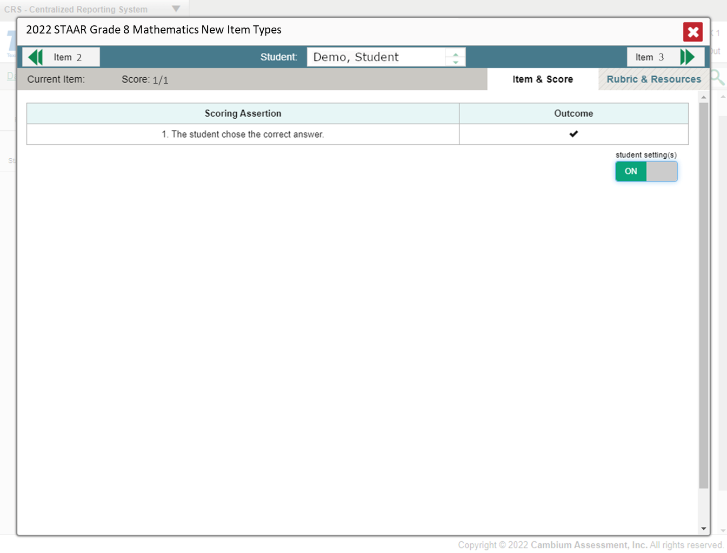
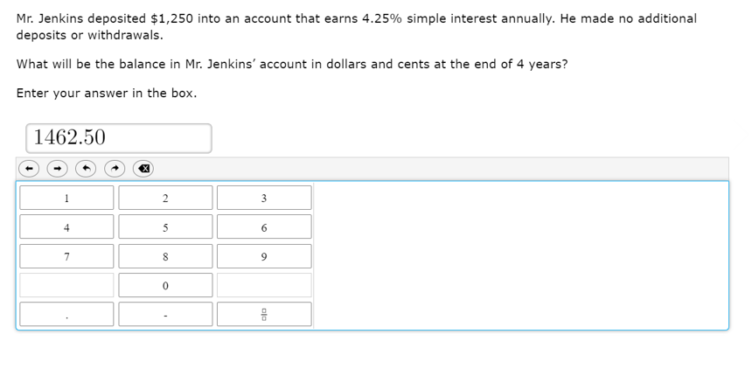
Question Type: Equation Editor Example #1: Teacher view
The scoring model for equation editor questions is:
To obtain full credit (1 point), the student will enter the correct answer in the box.
Students will receive 0 points if the answer is missing or incorrect.
In this example, this student entered the correct answer, so they received full credit (1 point).

Slide 14
Question Type: Graphing Question Type Overview
Description: Student selects, points, draws lines, drags bar graphs, and performs other functions to independently create different types of graphs.
Point value: These questions can be worth a maximum of 2 points with the possibility of receiving 1 point for a partially correct response.
Math tests that may include these questions: Grades 3-8, Spanish Grades 3-5, and EOC

Slide 15
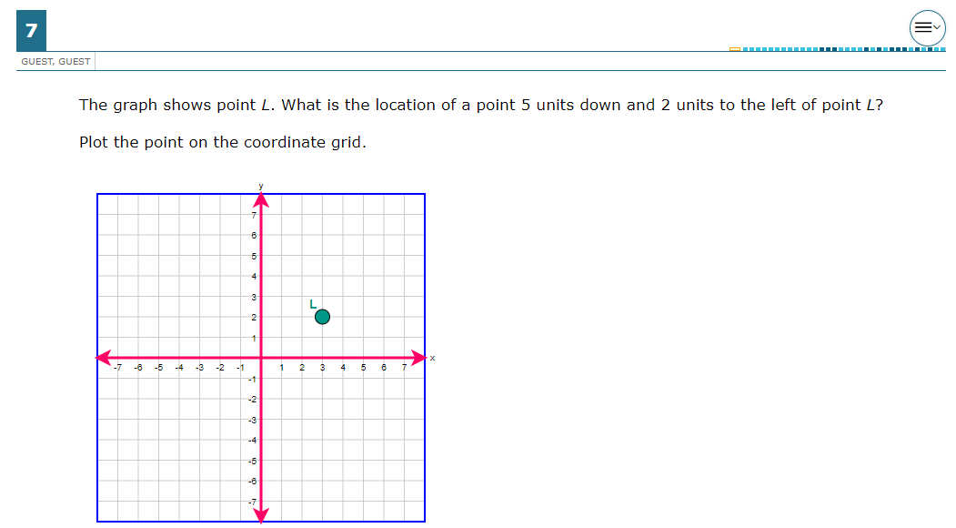
Question Type: Graphing Example #1: Student view
This example is question #7 in the Grade 6 sampler.

Slide 16
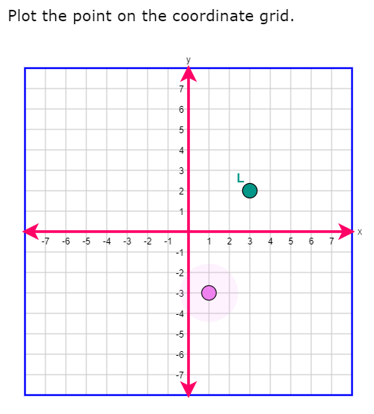
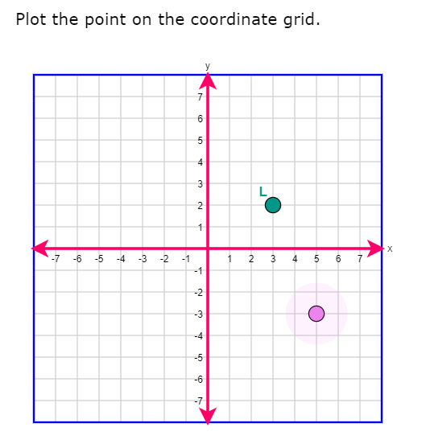
Question Type: Graphing Example #1: Student view
This is what the student will see when they select the correct answer (1 point).
This student did not answer select the correct answer (0 points).

Slide 17
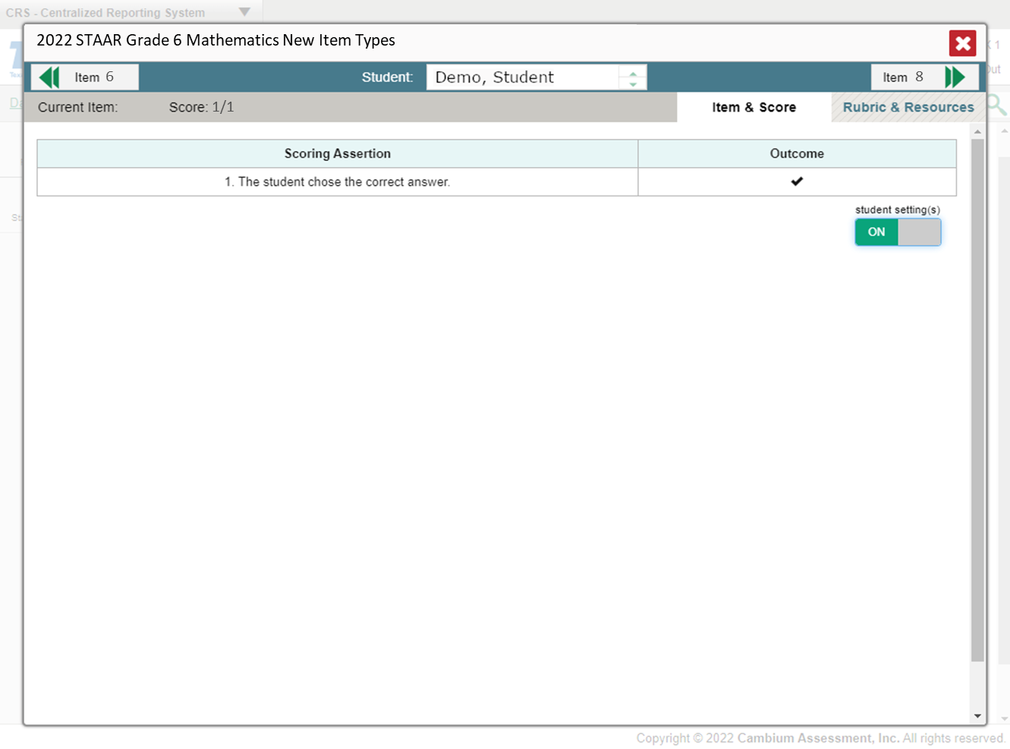
Question Type: Graphing Example #1: Teacher view
The scoring model for graphing questions is:
To obtain full credit (1 point), the student will correctly plot the point on the coordinate grid.
Students will receive 0 points if the point is missing or plotted incorrectly.
In this example, this student chose the correct answer, so they received full credit (1 point).

Slide 18
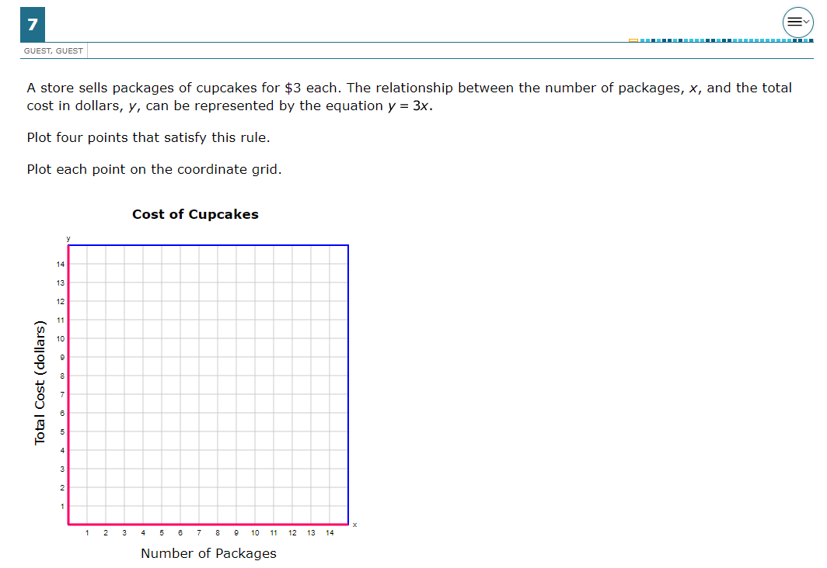
Question Type: Graphing Example #2: Student view
This example is question #7 in the Grade 5 sampler.

Slide 19
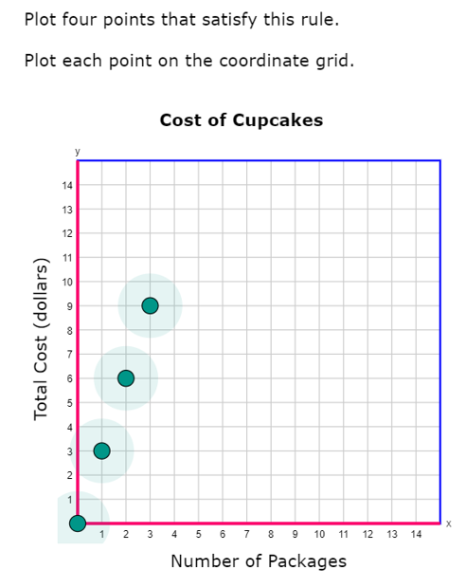
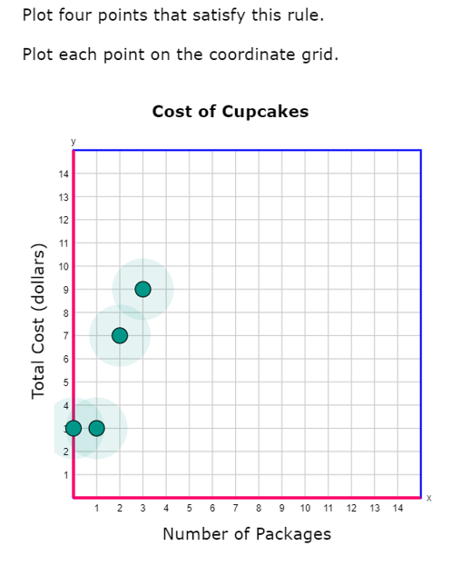
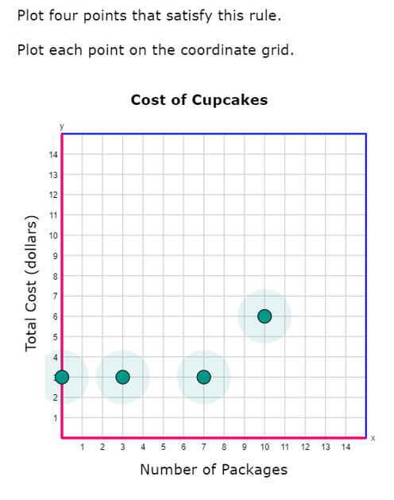
Question Type: Graphing Example #2: Student view
This is what the student will see when they correctly plot their answers (2 points).
This student plotted two points correctly (1 point).
This student plotted all four points incorrectly (0 points).

Slide 20
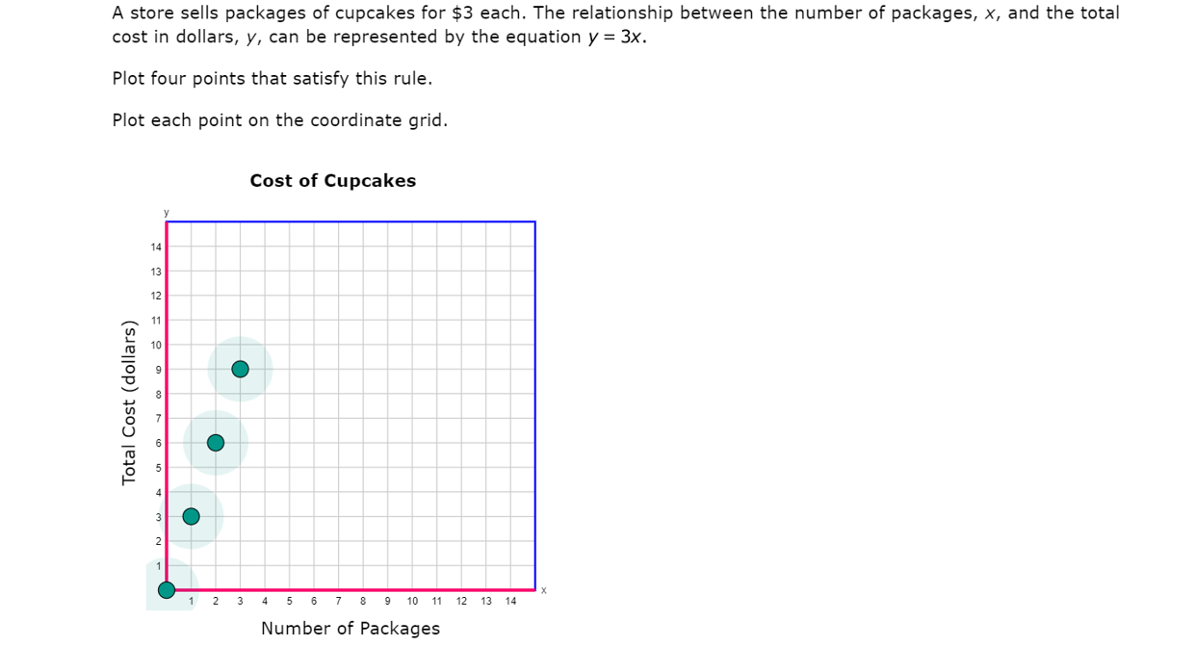
Question Type: Graphing Example #2: Teacher view
The scoring model for graphing questions is:
To obtain full credit (2 points), the student will correctly plot four points on the coordinate grid.
To obtain partial credit (1 point) the student will correctly plot two or three points on the coordinate grid.
Students will receive 0 points if three or more points are missing or plotted incorrectly.
This student plotted all four points correctly, so they received full credit (2 points).

Slide 21
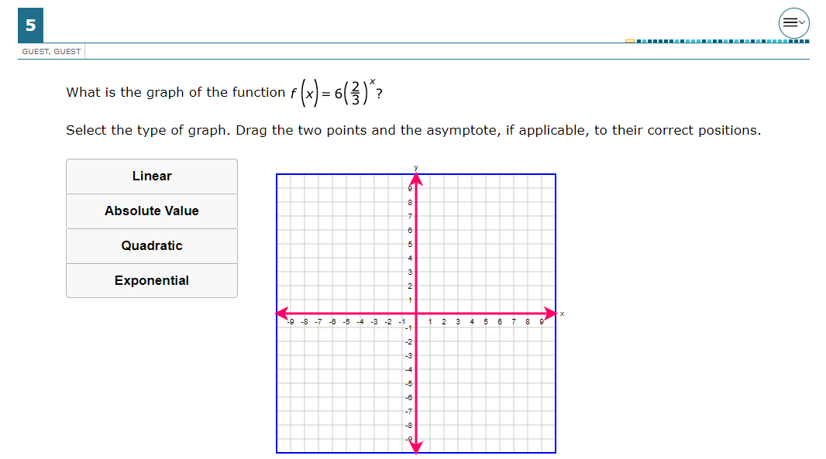
Question Type: Graphing Example #3: Student view
This example is question #5 in the Algebra I sampler.

Slide 22
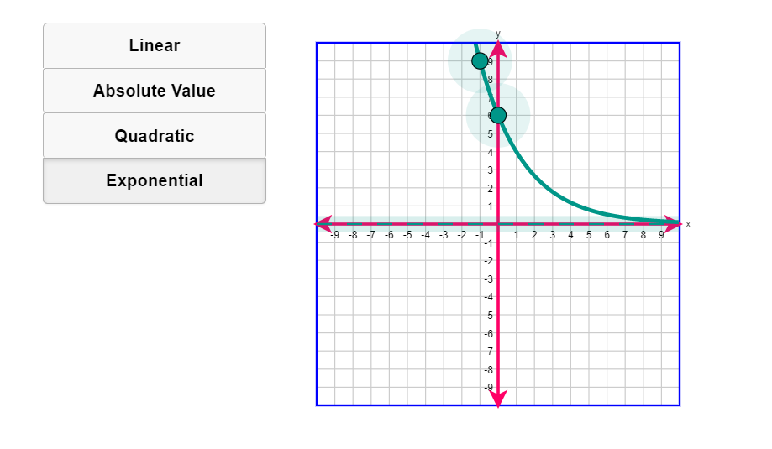
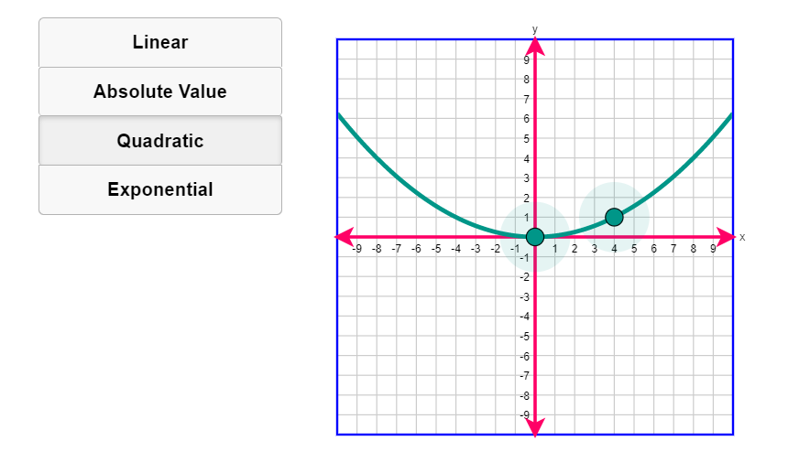
Question Type: Graphing Example #3: Student view
This is what the student will see when they select the correct answers (1 point).
This student did not select the correct answers (0 points).

Slide 23
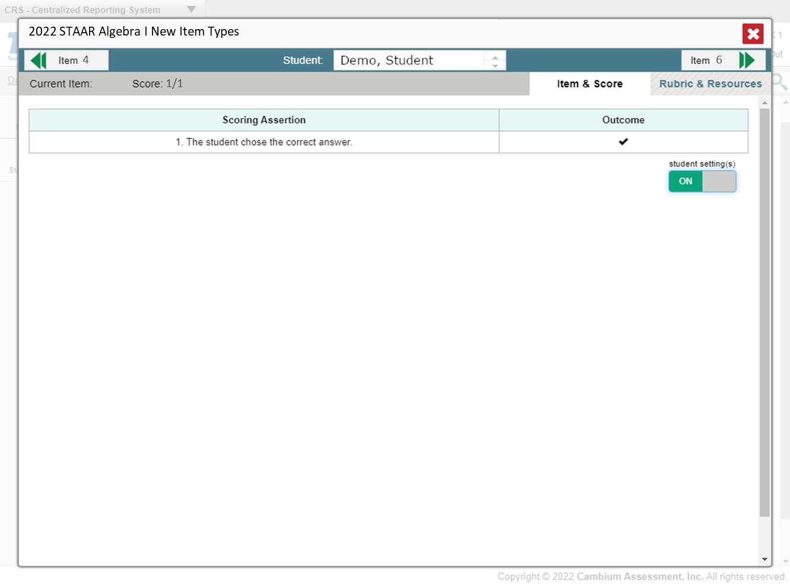
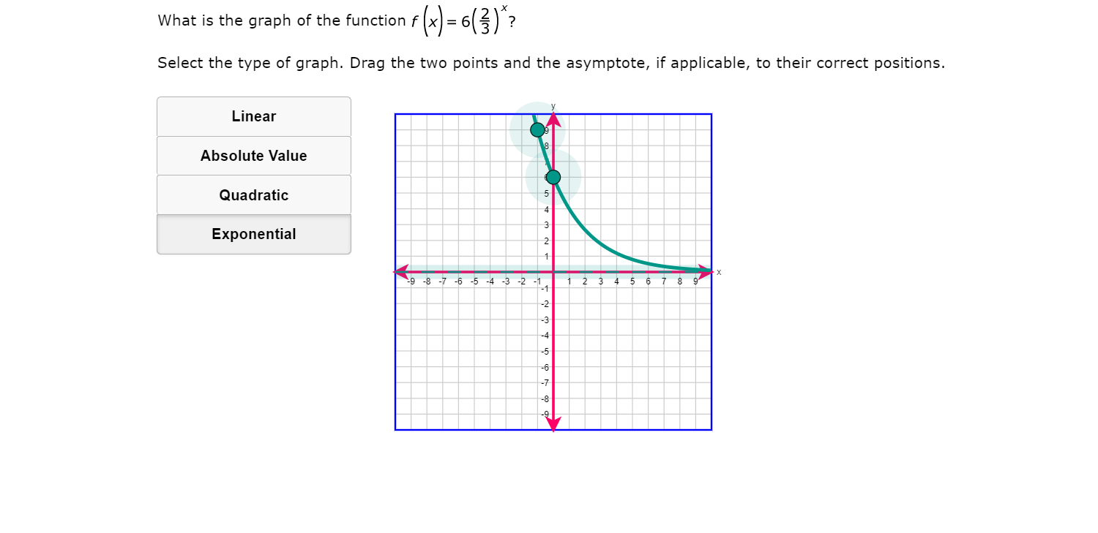
Question Type: Graphing Example #3: Teacher view
The scoring model for graphing questions is:
To obtain full credit (1 point), the student will correctly select the type of graph and drag the two points to their correct positions.
Students will receive 0 points if the type selection is incorrect or if any point is in the incorrect position.
In this example, this student answered correctly, so they received full credit (1 point).

Slide 24
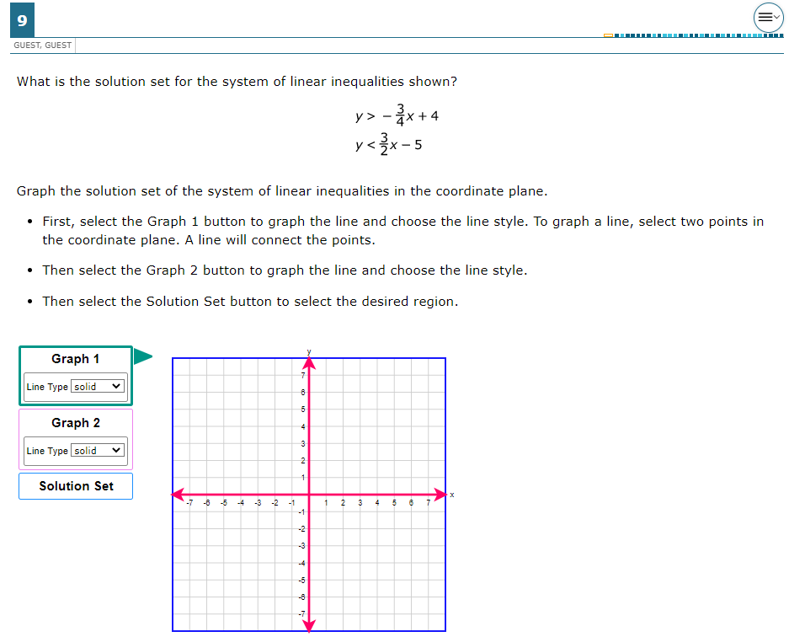
Question Type: Graphing Example #4: Student view
This example is question #9 in the Algebra I sampler.

Slide 25
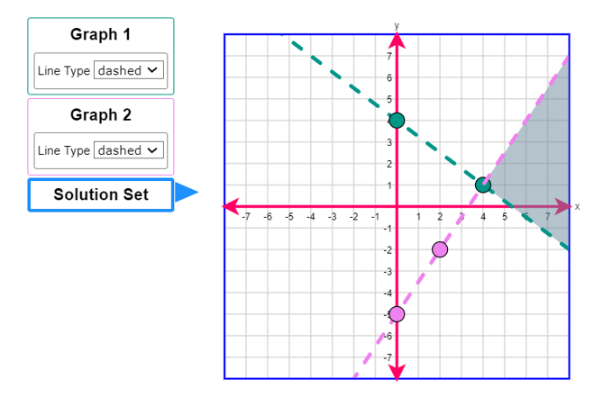
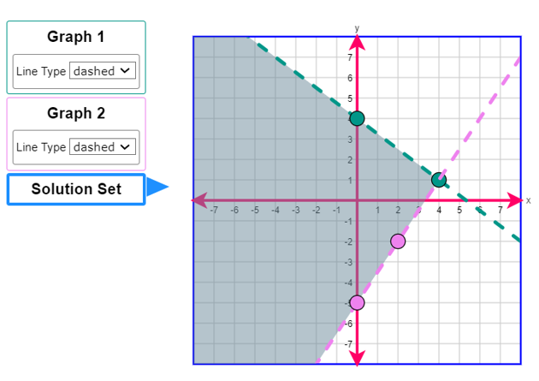
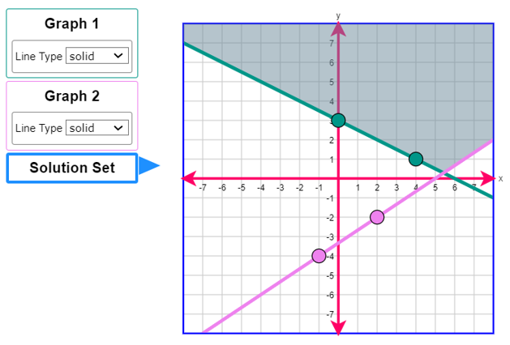
Question Type: Graphing Example #4: Student view
This is what the student will see when they select the correct answers (2 points).
This student correctly graphed both lines but did not shade the correct solution set, so they received partial credit (1 point).
This student incorrectly graphed both lines (0 points).

Slide 26
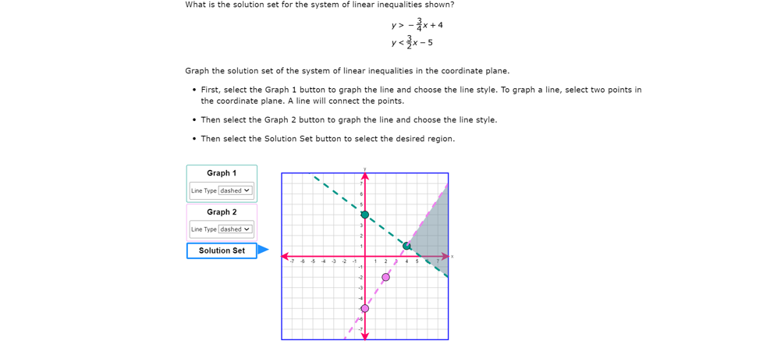
Question Type: Graphing Example #4: Teacher view
The scoring model for graphing questions is:
To obtain full credit (2 points), the student will correctly graph both lines with the correct line style and shade the correct solution set.
To obtain partial credit (1 point), the student will correctly graph both lines with the correct line style but not shade the correct solution set, or correctly graph both lines and shade the correct solution set but use an incorrect line style.
Students will receive 0 points if both lines are not correctly graphed.
In this example, this student correctly answered this question, so they received full credit (2 points).

Slide 27
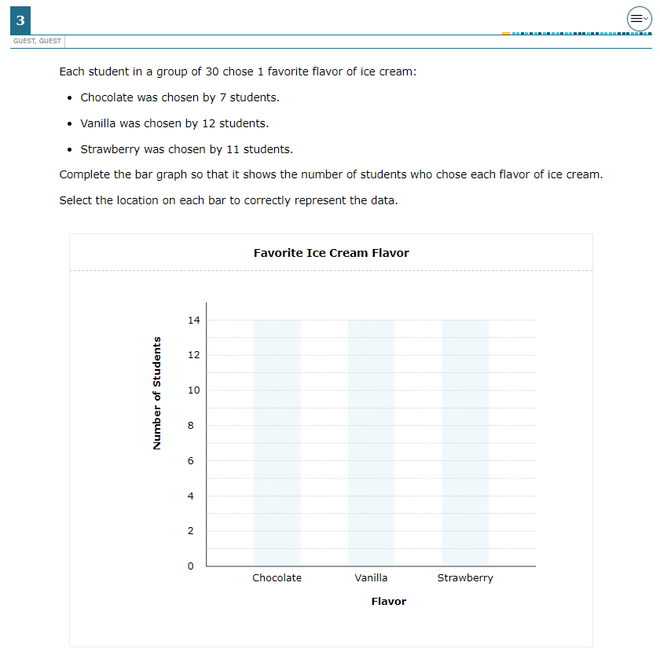
Question Type: Graphing Example #5: Student view
This example is question #3 in the Grade 3 sampler.

Slide 28
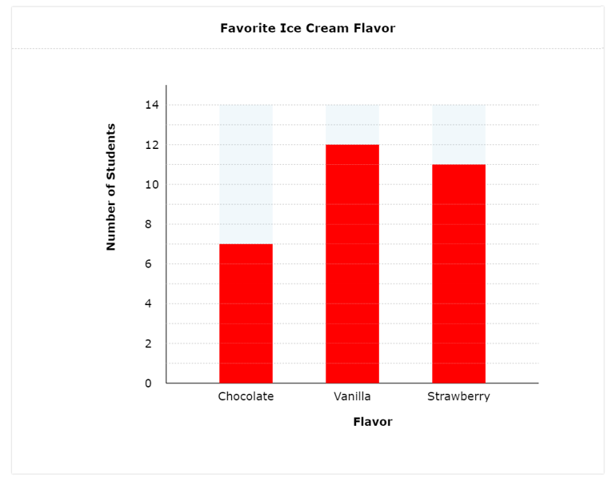
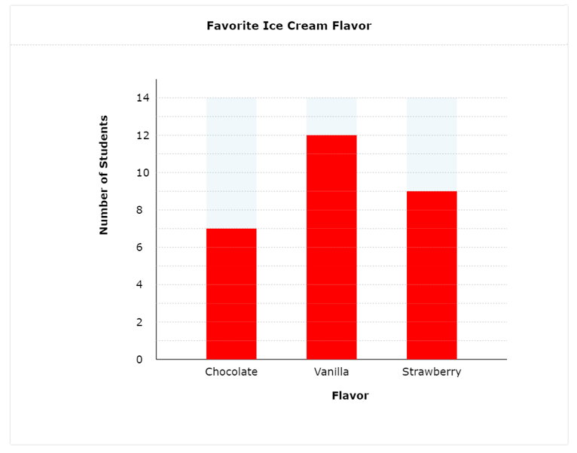
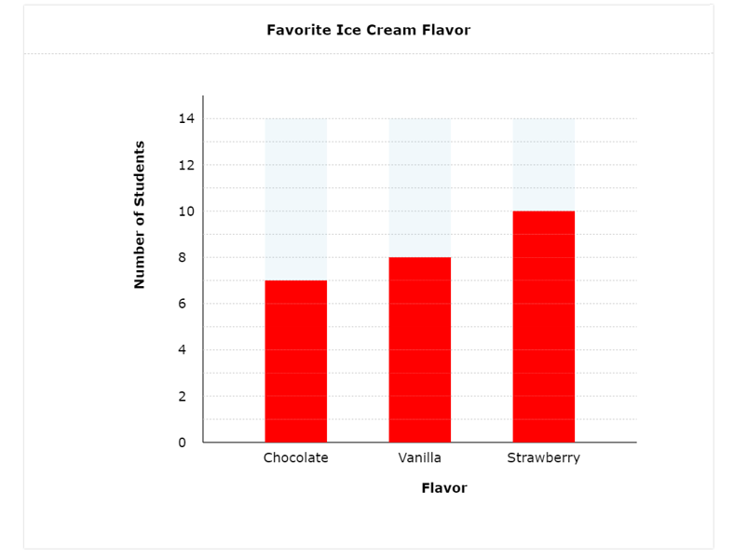
Question Type: Graphing Example #5: Student view
This is what the student will see when they select the correct answers (2 points).
This student correctly selected the location of two bars (1 point).
This student incorrectly selected the location of two bars (0 points).

Slide 29
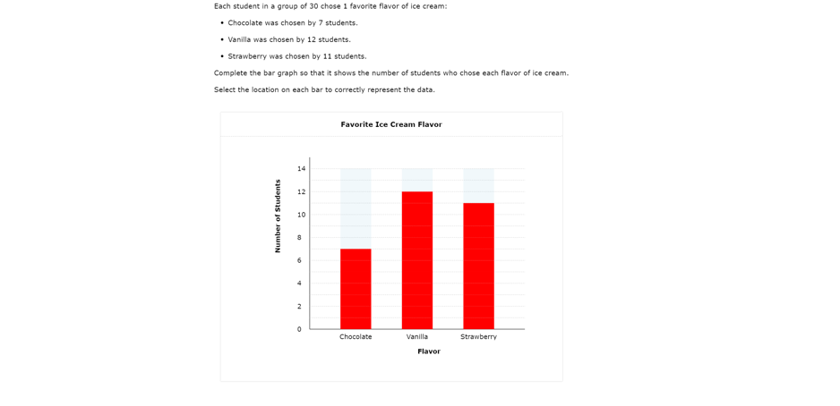
Question Type: Graphing Example #5: Teacher view
The scoring model for graphing questions is:
To obtain full credit (2 points), the student will correctly select the location of all three bars.
To obtain partial credit (1 point), the student will correctly select the location of two bars.
Students will receive 0 points if two or more bars are missing or incorrect
In this example, this student selected the correct location of all three bars, so they received full credit (2 points).

Slide 30
Question Type: Inline Choice Question Type Overview
Description: Student selects the correct answer(s) from one or more drop-down menu(s).
Point value: These questions can be worth a maximum of 2 points with the possibility of receiving 1 point for a partially correct response.
Math tests that may include these questions: Grades 3-8, Spanish Grades 3-5, and EOC

Slide 31
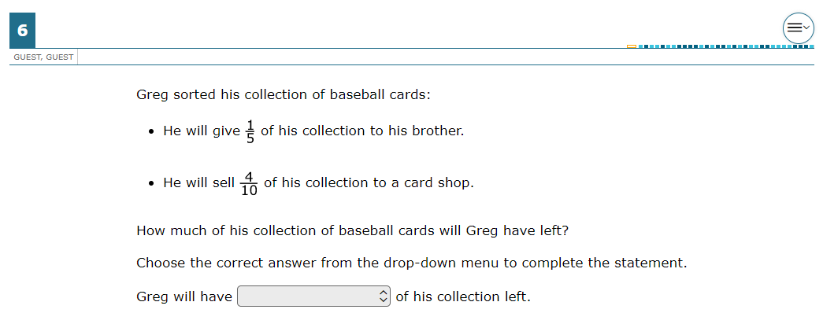
Question Type: Inline Choice Example #1: Student view
This example is question #6 in the Grade 4 sampler.

Slide 32
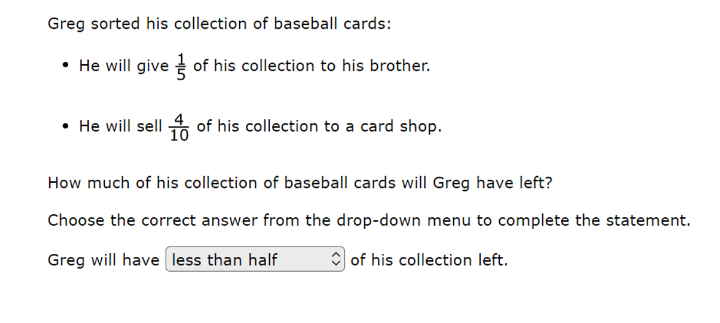
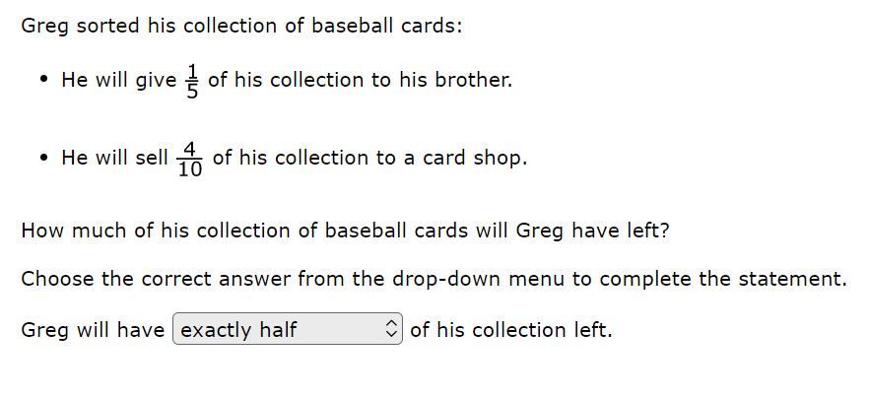
Question Type: Inline Choice Example #1: Student view
This is what the student will see when they select the correct answer (1 point).
This student chose an incorrect answer (0 points).

Slide 33
Question Type: Inline Choice Example #1: Teacher view
The scoring model for inline choice questions is:
To obtain full credit (1 point), the student will choose the correct answer from the drop-down menu.
Students will receive 0 points if the choice is missing or incorrect.
In this example, this student chose the correct answer, so they received full credit (1 point).

Slide 34
Question Type: Inline Choice Example #2: Student view
This example is question #10 in the Grade 7 sampler.
This is what the student will see when they select the correct answers (2pts).

Slide 35
Question Type: Inline Choice Example #2: Student view
This student chose one correct answer and one incorrect answer (1 point).
This student chose incorrect answers (0 points).

Slide 36
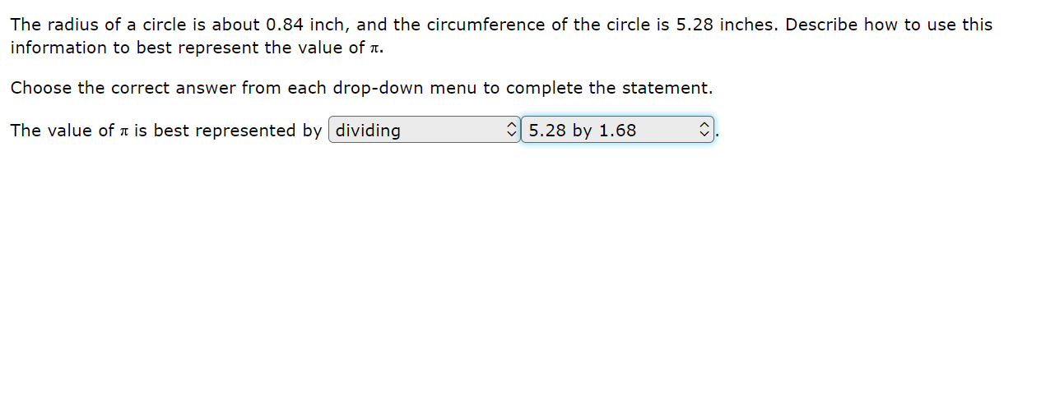
Question Type: Inline Choice Example #2: Teacher view
The scoring model for inline choice questions is:
To obtain full credit (2 points), the student will choose both correct answers from the drop-down menus.
To obtain partial credit (1 point), the student will choose one correct answer from one of the drop-down menus.
Students will receive 0 points if both choices are missing or incorrect.
This student chose both answers correctly, so they received full credit (2 points).

Slide 37
Question Type: Hot Spot Question Type Overview
Description: Student responds by selecting one or more specific areas of a graphic.
Point value: These questions can be worth a maximum of 2 points with the possibility of receiving 1 point for a partially correct response.
Math tests that may include these questions: Grades 3-8, Spanish Grades 3-5, and EOC

Slide 38
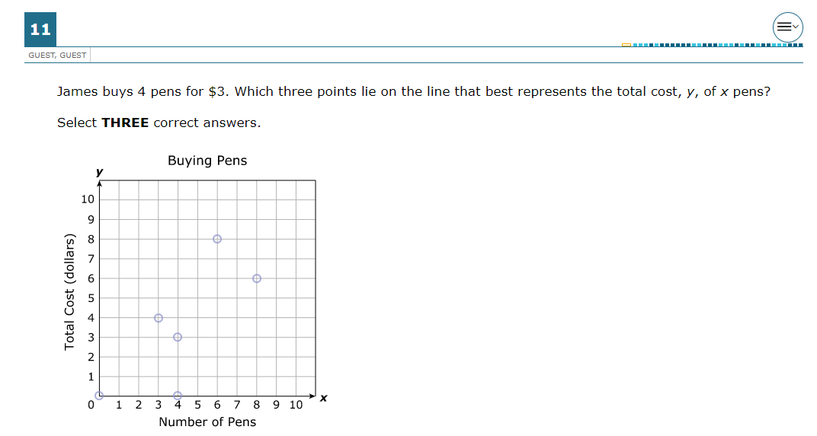
Question Type: Hot Spot Example #1: Student view
This example is question #11 in the Grade 7 sampler.

Slide 39
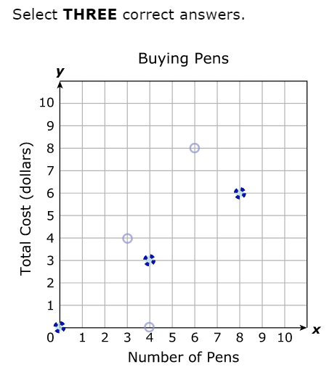
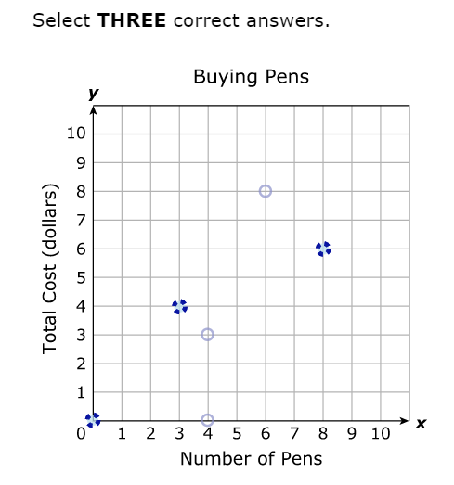
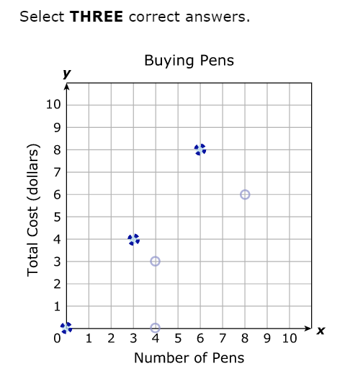
Question Type: Hot Spot Example #1: Student view
This is what the student will see when they select the correct answers (2 points).
This student selected two correct points (1 point).
This student selected two incorrect points (0 points).

Slide 40
Question Type: Hot Spot Example #1: Teacher view
The scoring model for hot spot questions is:
To obtain full credit (2 points), the student will correctly select three points on the line.
To obtain partial credit (1 point), the student will correctly select two points on the line.
Students will receive 0 points if two points are missing or incorrect.
In this example, this student selected all correct three points on the line, so they received full credit (2 points).

Slide 41
Question Type: Hot Spot Example #2: Student view
This example is question #8 in the Grade 4 sampler.

Slide 42
Question Type: Hot Spot Example #2: Student view
This is what the student will see when they select the correct answer (1 point).
This student did not select the correct answer (0 points).

Slide 43
Question Type: Hot Spot Example #2: Teacher view
The scoring model for hot spot questions is:
To obtain full credit (1 point), the student will correctly select the location on the number line.
Students will receive 0 points if the location is missing or incorrect.
In this example, this student selected the correct location, so they received full credit (1 point).

Slide 44
Question Type: Fraction Model Question Type Overview
Description: Student represents a fraction by dividing an object into the correct number of sections to indicate the denominator and clicking to shade the appropriate number of sections to indicate the numerator.
Point value: These questions can be worth a maximum of 2 points with the possibility of receiving 1 point for a partially correct response.
Math tests that may include these questions: Grades 3-5 and Spanish Grades 3-5

Slide 45
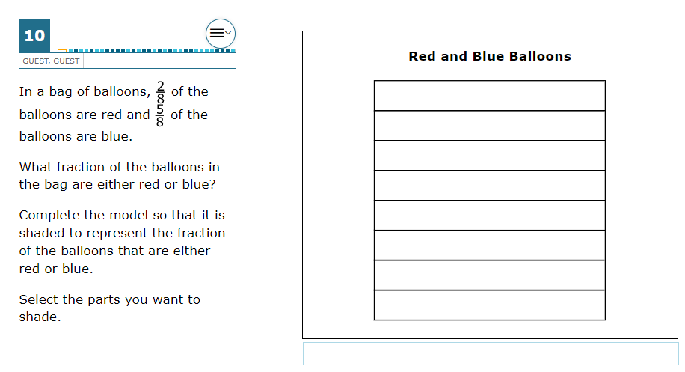
Question Type: Fraction Model Example #1: Student view
This example is question #10 in the Grade 4 sampler.

Slide 46
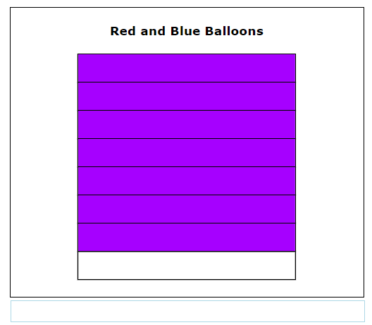
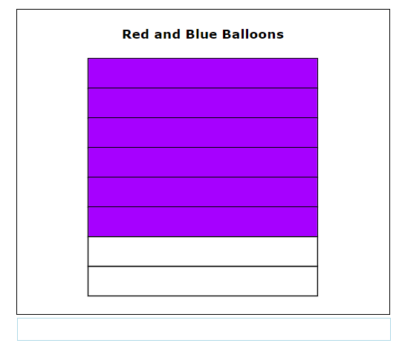
Question Type: Fraction Model Example #1: Student view
This is what the student will see when they select the correct answer (1 point).
This student did not select the correct answer (0 points).

Slide 47
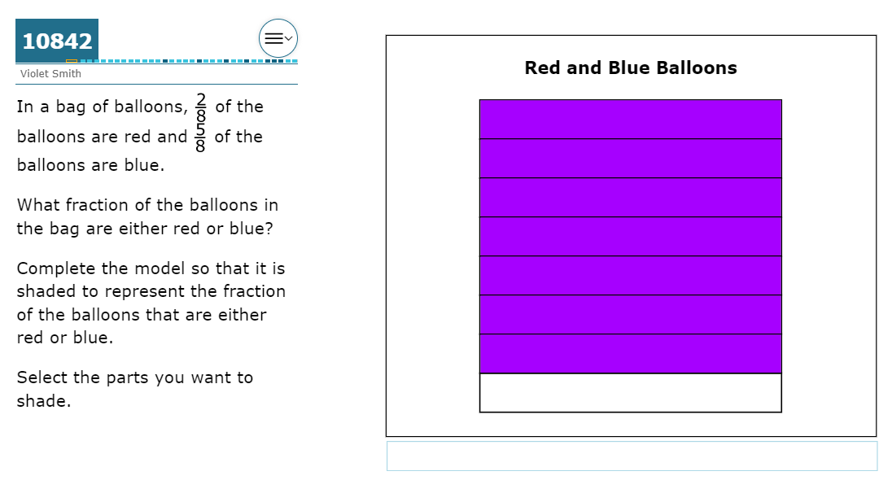
Question Type: Fraction Model Example #1: Teacher view
The scoring model for fraction model questions is:
To obtain full credit (1 points), the student will correctly complete the model with shading.
Students will receive 0 points if the model is not shaded correctly.
In this example this student correctly shaded the model, so they received full credit (1 point).

Slide 48
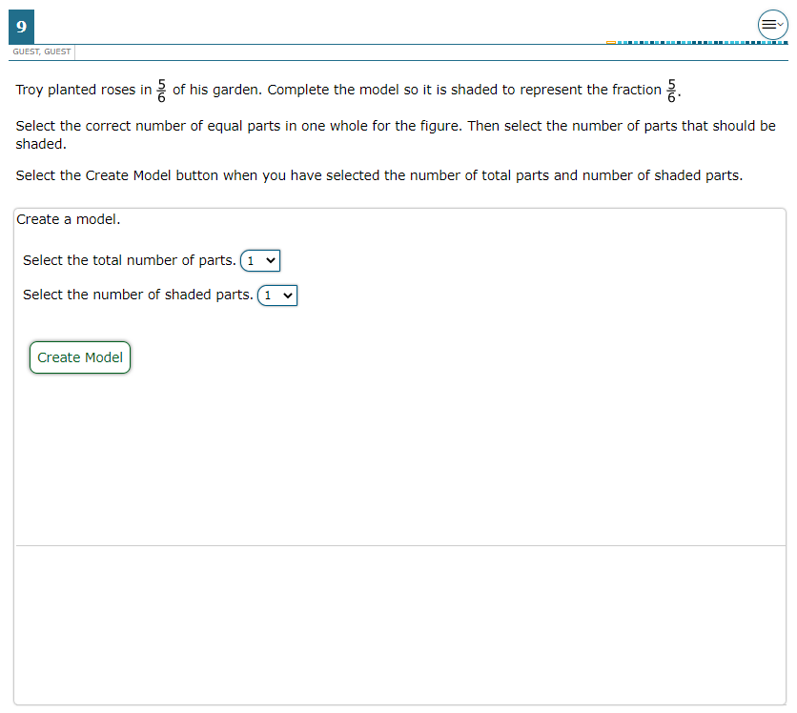
Question Type: Fraction Model Example #2: Student view
This example is question #9 in the Grade 3 sampler.

Slide 49
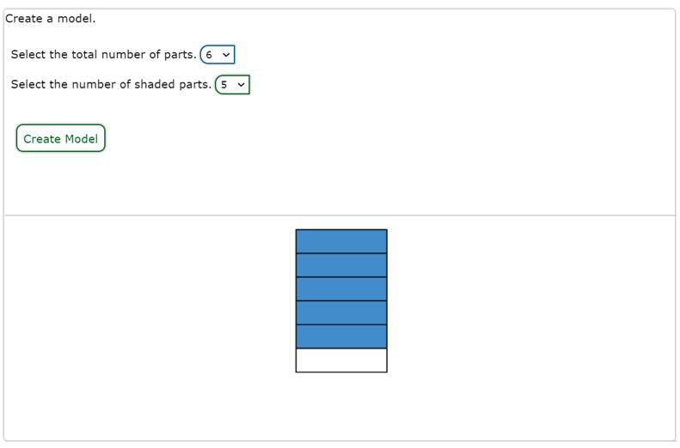
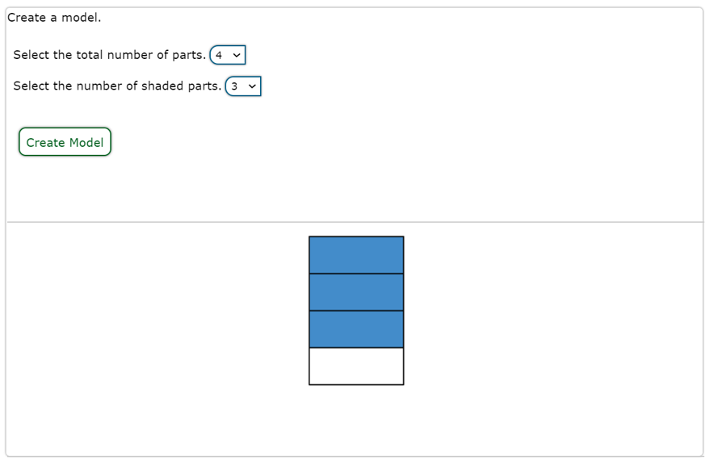
Question Type: Fraction Model Example #2: Student view
This is what the student will see when they select the correct answers (1 point).
This student selected incorrect answers (0 points).

Slide 50
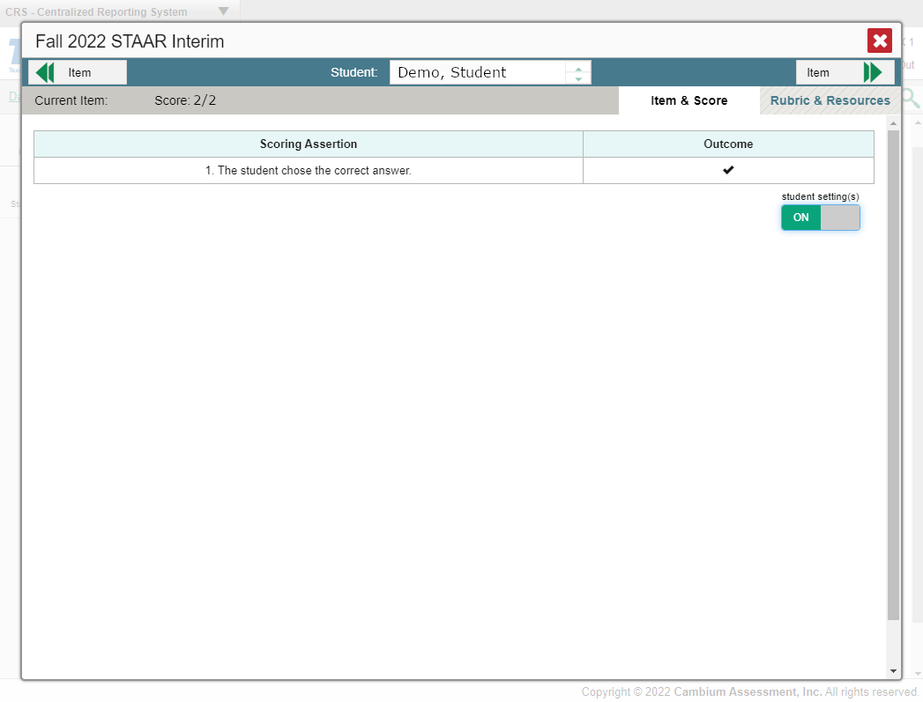
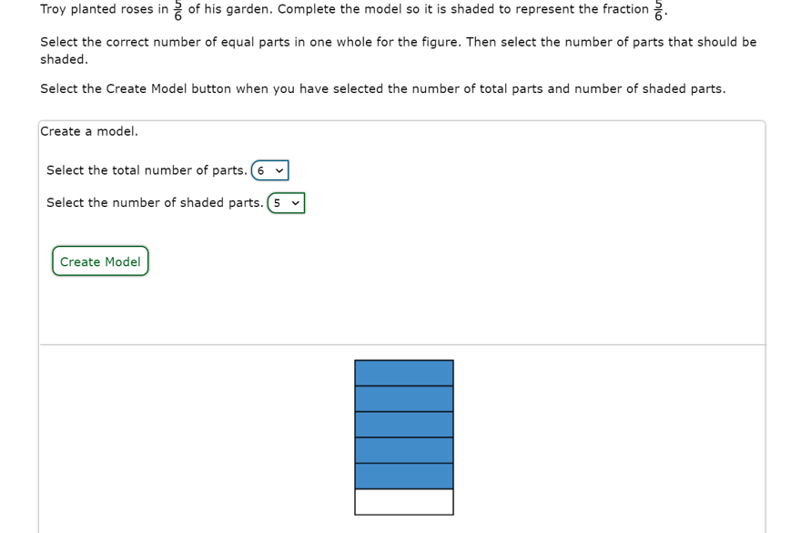
Question Type: Fraction Model Example #2: Teacher view
2022 STAAR Grade 3 Mathematics New Item Types
The scoring model for fraction model questions is:
To obtain full credit (1 point), the student will correctly select the total number of parts and the number of shaded parts.
Students will receive 0 points if either selection is missing or incorrect.
In this example, this student chose correct answers, so they received full credit (1 point).
8
10
1/1

Slide 51
Question Type: Drag and Drop Question Type Overview
Description: Student evaluates a given number of options (words, numbers, symbols, etc.) and chooses which response(s) to drag to a given area (a diagram, map, chart, etc.).
Point value: These questions can be worth a maximum of 2 points with the possibility of receiving 1 point for a partially correct response.
Math tests that may include these questions: Grades 3-8, Spanish Grades 3-5, and EOC

Slide 52
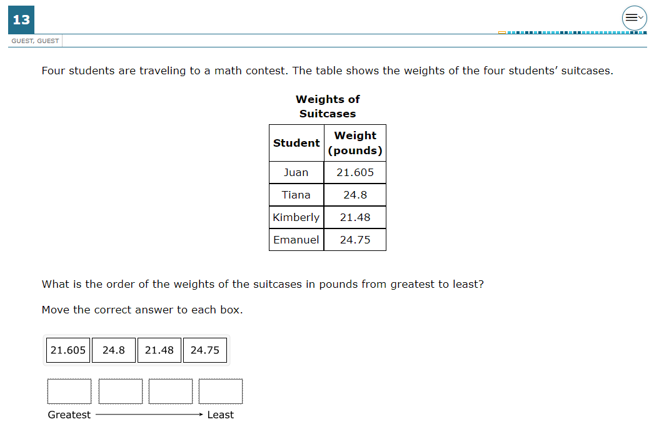
Question Type: Drag and Drop Example #1: Student view
This example is question #13 in the Grade 5 sampler.

Slide 53
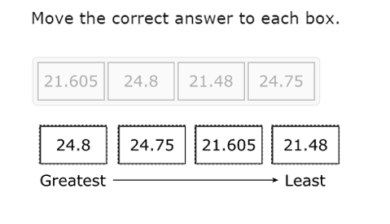
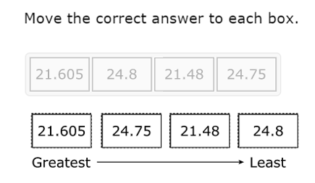
Question Type: Drag and Drop Example #1: Student view
This is what the student will see when they move their answers to the correct boxes (1 point).
This student did not move all the answers to the correct boxes (0 points).

Slide 54
Question Type: Drag and Drop Example #1: Teacher view
The scoring model for drag and drop questions is:
To obtain full credit (1 point), the student will correctly move the answer to each box from greatest to least weight.
Students will receive 0 points if any answer is missing or incorrectly placed.
In this example, this student moved all the answers to correct boxes, so they received full credit (1 point).

Slide 55
Question Type: Drag and Drop Example #2: Student view
This example is question #18 in the Algebra I sampler.

Slide 56
Question Type: Drag and Drop Example #2: Student view
This is what the student will see when they select the correct answers (2 points).
This student chose one correct answer and one incorrect answer (1 point).
This student chose two incorrect answers (0 points).

Slide 57
Question Type: Drag and Drop Example #2: Teacher view
The scoring model for drag and drop questions is:
To obtain full credit (2 points), the student will move the correct answer to both boxes.
To obtain partial credit (1 point), the student will move the correct answer to one of the boxes.
Students will receive 0 points if both answers are missing or incorrect.
In this example, this student moved all the answers to the correct boxes, so they received full credit (2 points).

Slide 58
Question Type: Match Table Grid Question Type Overview
Description: Student matches statements or objects to different categories presented in a table grid.
Point value: These questions can be worth a maximum of 2 points with the possibility of receiving 1 point for a partially correct response.
Math tests that may include these questions: Grades 6-8 and EOC

Slide 59
Question Type: Match Table Grid Example #1: Student view
This example is question #19 in the Algebra I sampler.

Slide 60
Question Type: Match Table Grid Example #1: Student view
This is what the student will see when they select the correct answers (2 points).
This student chose two correct answers and one incorrect answer (1 point).
This student chose two incorrect answers (0 points).

Slide 61
Question Type: Match Table Grid Example #1: Teacher view
The scoring model for match table grid questions is:
To obtain full credit (2 points), the student will correctly classify all three relations as a function or not a function.
To obtain partial credit (1 point), the student will correctly classify two of the relations.
Students will receive 0 points if two or more classifications are missing or incorrect.
In this example, this student selected all correct answers, so they received full credit (2 points).

Slide 62
Question Type: Multiselect Question Type Overview
Description: Student can select more than one correct answer from a set of possible answers. Student will not be allowed to select more than the specified number of correct answers asked for within an individual question.
Point value: These questions can be worth a maximum of 2 points with the possibility of receiving 1 point for a partially correct response.
Math tests that may include these questions: Grades 3-8, Spanish Grades 3-5, and EOC

Slide 63
Question Type: Multiselect Example #1: Student view
This example is question #21 in the Algebra I sampler.

Slide 64
Question Type: Multiselect Example #1: Student view
This is what the student will see when they select the correct answers (2 points).
This student chose one correct answer and one incorrect answer (1 point).
This student chose two incorrect answers (0 points).

Slide 65
Question Type Multiselect Example #1: Teacher view
The scoring model for multiselect questions is:
To obtain full credit (2 points), the student will correctly select the domain and range of the function.
To obtain partial credit (1 point), the student will correctly select either the domain or range of the function.
Students will receive 0 points if both selections are missing or incorrect.
This student correctly selected the domain and range of the function, so they received full credit (2 points).

Slide 66
Additional Resources
Additional information about STAAR and STAAR Redesign is available via the following links:
STAAR Redesign Resources
STAAR Mathematics Resources
STAAR Resources for all Assessments

